Slide 1
Birthday Planning!
You need to plan a birthday party for you and your friends. Your parents told you they would pay as long as you found out how much everything costs.

Slide 2
Dave and Busters
Arcade Games
Pizza
Dessert
Party Favors
Plates, cups, hats
This Photo by Unknown Author is licensed under CC BY-SA

Slide 3
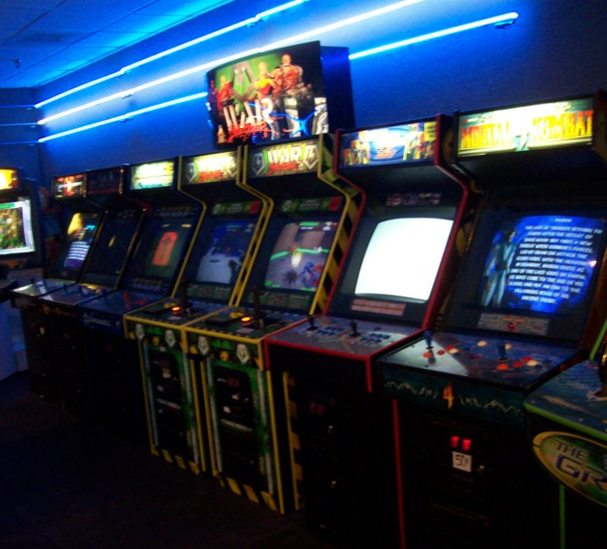
Arcade Games 8 kids will be at your party
For each kid to get a wristband to play arcade games it costs a total of $ 372.
About how much do the arcade games cost per person?

Slide 4
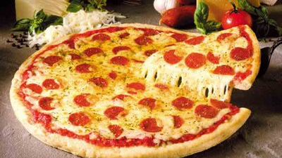
Pizza For 8 kids + 2 parents
You need enough pizza for each person to have two slices. Which means you need 20 slices.
Each pizza has 8 slices so you will need 3 pizzas. You decide to get 4 pizzas just in case.
Your parents will pay $119. About how much will each box of pizza cost? About how much will each slice cost?
This Photo by Unknown Author is licensed under CC BY

Slide 5
Dessert For 8 kids + 2 parents
You are getting a cupcake for everyone. The cupcakes cost a total of $77. Your parents want to get them personalized which adds an extra fee of $12 to the order.
About how much would it cost for each cupcake?
This Photo by Unknown Author is licensed under CC BY-NC

Slide 6
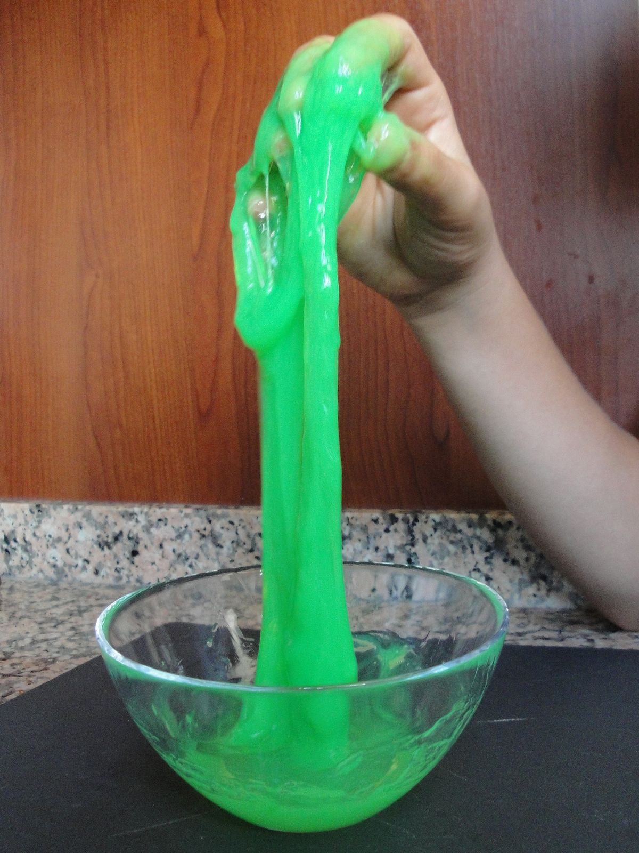
Party Favors 7 kids
For the party favor you gave everyone a tin of slime.
It will cost a total of $73. How much does each slime cost?
This Photo by Unknown Author is licensed under CC BY-SA

Slide 7
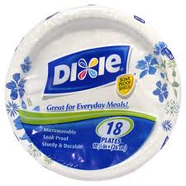
Plates, Cups, and Hats 8 kids
You need a pack of 50 plates for dinner and dessert. The pack costs $8.
You need a 25 pack of cups. It costs $7.
A pack of 10 party hats costs $9.
Find the total cost. Then calculate exactly how much it costs per person.
This Photo by Unknown Author is licensed under CC BY-ND
This Photo by Unknown Author is licensed under CC BY-NC-ND
This Photo by Unknown Author is licensed under CC BY-NC-ND

Slide 8
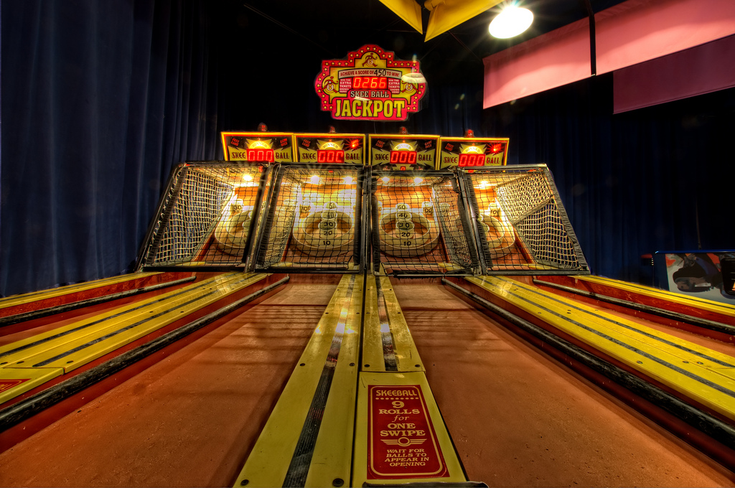
Calculate The Total!
Arcade Games: $372
Pizza: $119
Dessert: $77 + $12
Party Favors: $73
Plates, cups, hats: $8 + $7 + $9
HAVE FUN AT YOUR
BIRTHDAY PARTY!

